Slide 1
TEST EXECUTION & DEFECT REPORT
Automation Testing vs. Manual Testing
Lulu Mall, Bengaluru (Automated) | Kothamangalam Agro Tourism (Manual)
Prepared by: RESIK S.R
28 September 2026

Slide 2
AGENDA
Two testing approaches, one report
PART A
PART B
Automation Testing
Manual Testing
Lulu Mall, Bengaluru
Kothamangalam Agro Tourism
• Selenium + TestNG + Java script sample
• What was done — process followed
• Test execution results
• Defect screenshots (real evidence)
• Defect summary & evidence
• Defect summary & critical issue
2

Slide 3
DEFECT OVERVIEW — BOTH PROJECTS
37 open defects across both projects
37
3
3
30
1
Total Open Defects
Critical
High
Medium
Low
By project and severity
Project | Total | Critical | High | Medium | Low
Lulu Mall Bengaluru (Automation) | 11 | 2 | 2 | 7 | 0
Kothamangalam Agro Tourism (Manual) | 26 | 1 | 1 | 23 | 1
Combined | 37 | 3 | 3 | 30 | 1
3 critical defects total — 2 block the Lulu Cinepolis booking flow, 1 blocks the Kothamangalam farm-stay reservation. Both are covered in detail in Parts A and B.
3

Slide 4
PART A
PART A
Automation Testing
Lulu Mall, Bengaluru — www.bengaluru.lulumall.in
Java + Selenium + TestNG
8
185
264
Tech Stack
Modules Automated
Test Classes
@Test Methods
Modules covered: Home, Shop, Dine, Entertainment, Offer, Events, Contact Us, Location
Approach: one test class per UI element/interaction, run with TestNG — page load and scroll in @BeforeMethod, click/interaction and wait-based verification in @Test.

Slide 5
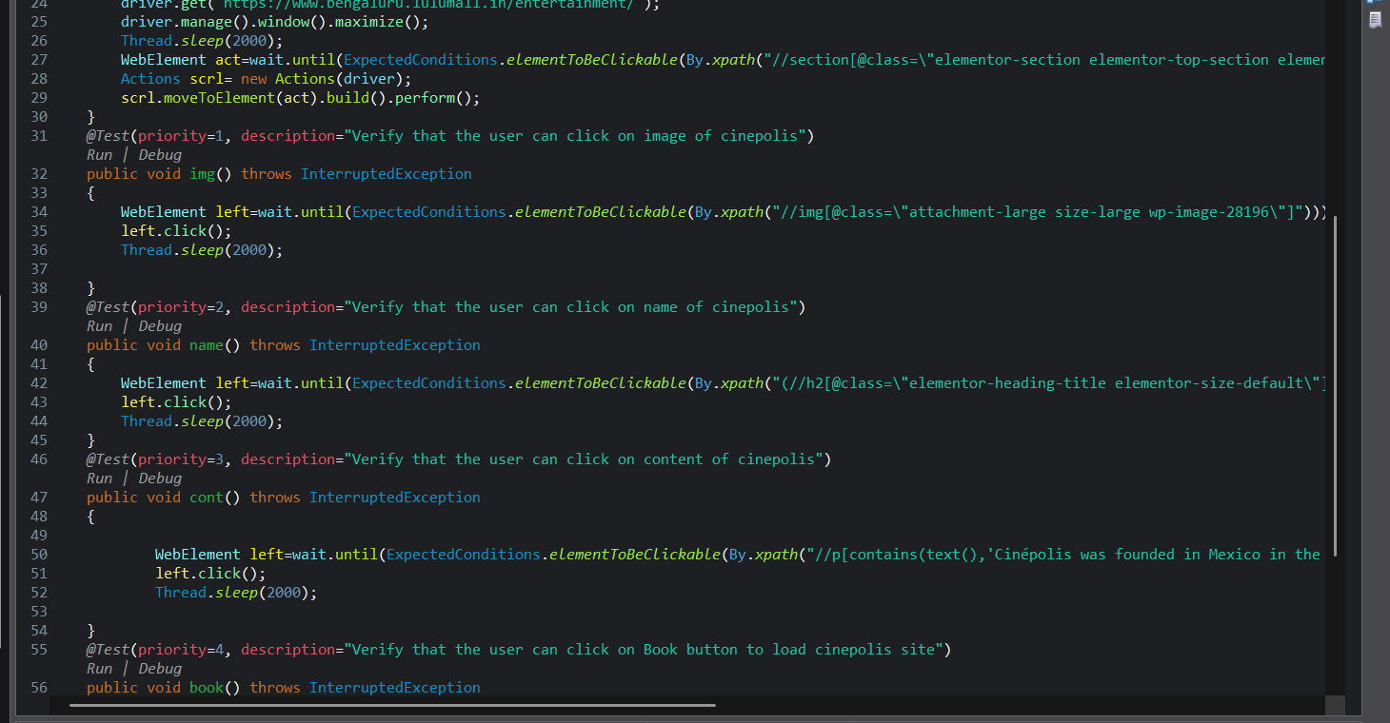
PART A — AUTOMATION TESTING
The script: Cinepolis.java
Entertainment module — Selenium/TestNG test class (as written in Eclipse)
How it's built
• @BeforeMethod loads the page and scrolls to the target section
• Each @Test(priority = n) clicks one element (image, name, content, book button)
• WebDriverWait + ExpectedConditions wait for the element before acting
• This exact class covers the image, name, content-link and Book-button checks that surfaced the two critical Cinepolis defects (slide 5)
4

Slide 6
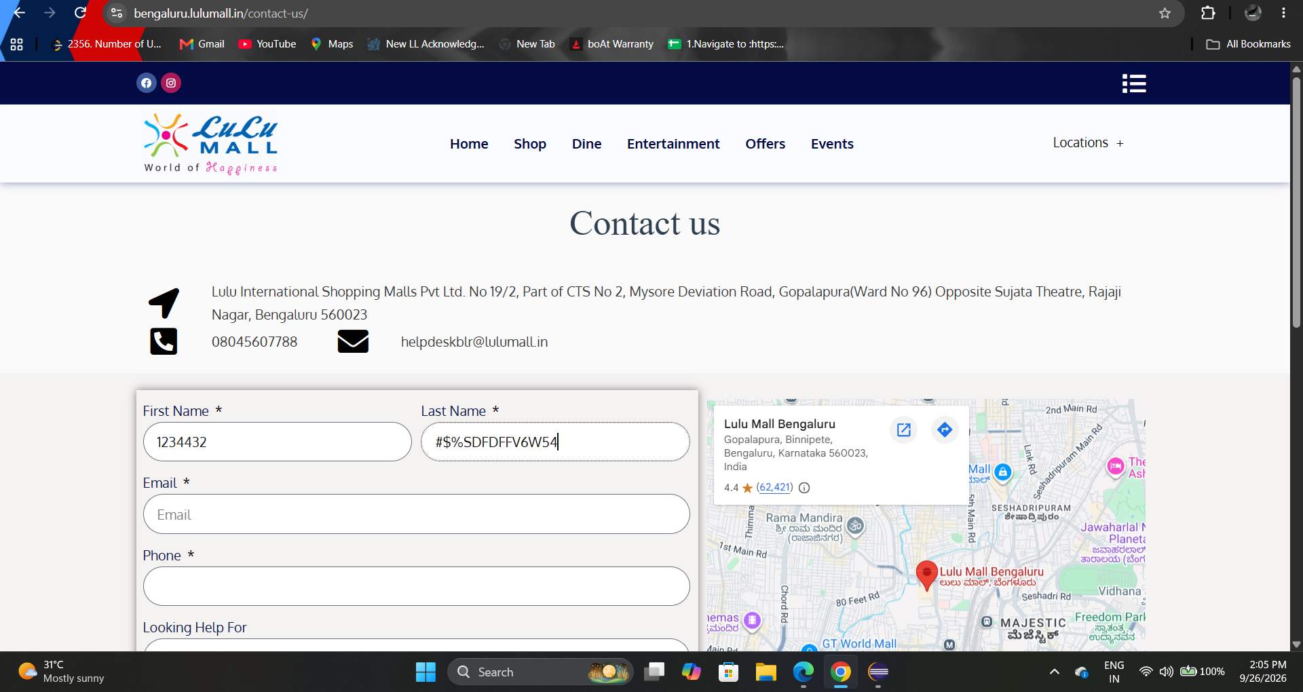
PART A — AUTOMATION TESTING
11 open defects logged
By severity
Evidence — BUG_LULU_11 (Contact Us)
Invalid characters ("1234432", "#$%SDFDFFV6W54") accepted in the Name fields — form does not validate input as expected.
5

Slide 7
PART B
Manual Testing
Kothamangalam Agro Tourism (EchoTourism) — kothamangalamagrotourism.in
102
6
26
Total Test Cases
Site Sections Tested
Total Defects Logged
What I did (no automation script — every case executed by hand):
1
Wrote manual test cases for all 6 site sections (Header, Footer, Home, Experience, Stay, Contact Us) in a shared test case sheet.
2
Navigated each page in the browser and performed every step listed — clicking links, images, icons and buttons exactly as documented.
3
Recorded the Actual Result against the Expected Result for every test case, and marked each Pass or Fail.
4
Logged every Fail as a separate defect (BUG_KOTGM_01–26) with Module, Priority, Severity and a reference screenshot.

Slide 8
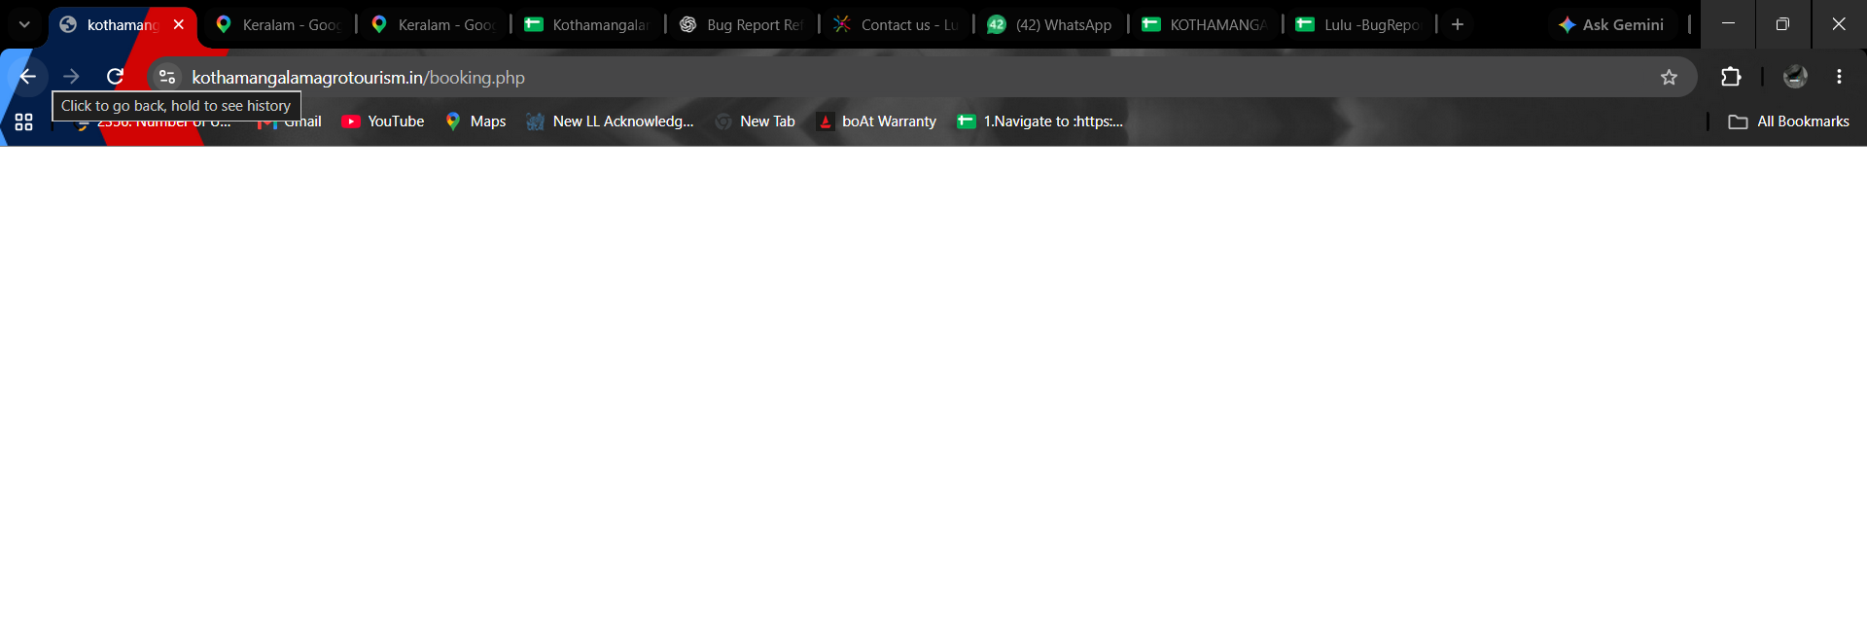
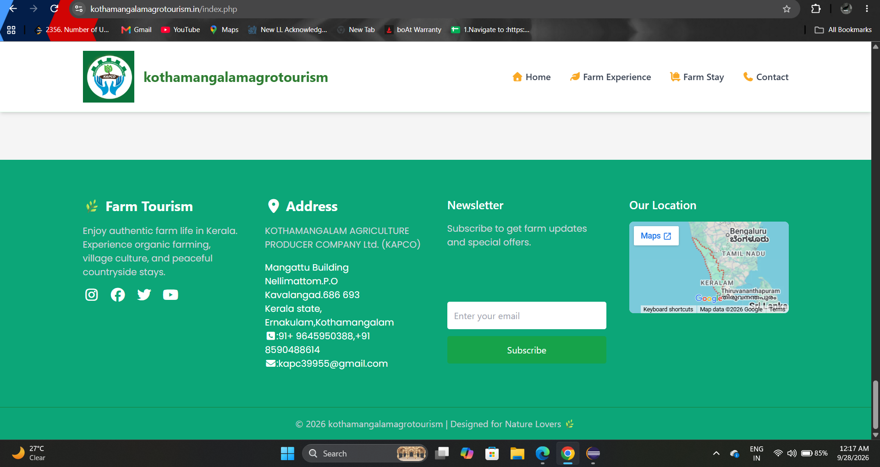
PART B — MANUAL TESTING
Defect evidence — real screenshots
BUG_KOTGM_17 — Critical
Footer — BUG_KOTGM_03 to 07
Clicking "Reserve your stay" navigates to booking.php — the page loads completely blank instead of a booking window.
Social links, address/map, call, mail and the subscribe button under this footer section were all logged as not working as expected.
6

Slide 9
PART B — MANUAL TESTING
26 open defects logged
By site section
1 CRITICAL
BUG_KOTGM_17 — "Reserve your stay" opens a blank page instead of the booking window
By priority
7

Slide 10
RECOMMENDATIONS
Next steps
1
Fix and retest the two booking-critical defects first — Lulu Cinepolis booking and the Kothamangalam farm-stay reservation blank page.
2
Complete the 7 not-yet-run Lulu Mall HOME test cases and the SHOP module retest.
3
Add input validation on the Lulu Contact Us form — Name fields currently accept numbers and symbols.
4
Standardise defect status values (Open / Fixed / Retest / Closed) across both trackers.
Thank you

